Slide 1
21CSS201T COMPUTER ORGANIZATION AND ARCHITECTURE UNIT-1 Topic : Memory Locations and Addresses

Slide 2
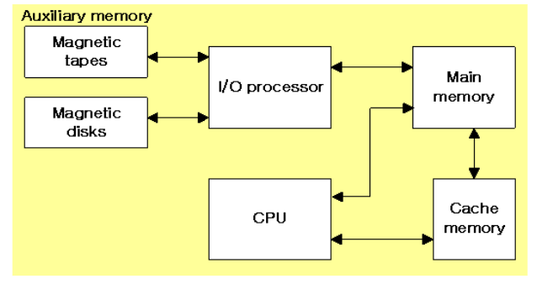
MEMORY HIERARCHY
Memory Hierarchy is to obtain the highest possible
access speed while minimizing the total cost of the memory system

Slide 3
Memory Locations and Addresses
Memory consists of many millions of storage cells, each of which can store 1 bit.
Data is usually accessed in n-bit groups. n is called word length.
The memory of a computer can be schematically represented as a collection of words as shown in Figure 1.
n
bits
first word
second word
•
•
•
i
th word
•
•
•
last word
Figure 1 Main Memory words.

Slide 4
MEMORY LOCATIONS AND ADDRESSES
Main memory is the second major subsystem in a computer. It consists of a collection of storage locations, each with a unique identifier, called an address.
Data is transferred to and from memory in groups of bits called words. A word can be a group of 8 bits, 16 bits, 32 bits or 64 bits (and growing).
If the word is 8 bits, it is referred to as a byte. The term “byte” is so common in computer science that sometimes a 16-bit word is referred to as a 2-byte word, or a 32-bit word is referred to as a 4-byte word.

Slide 5
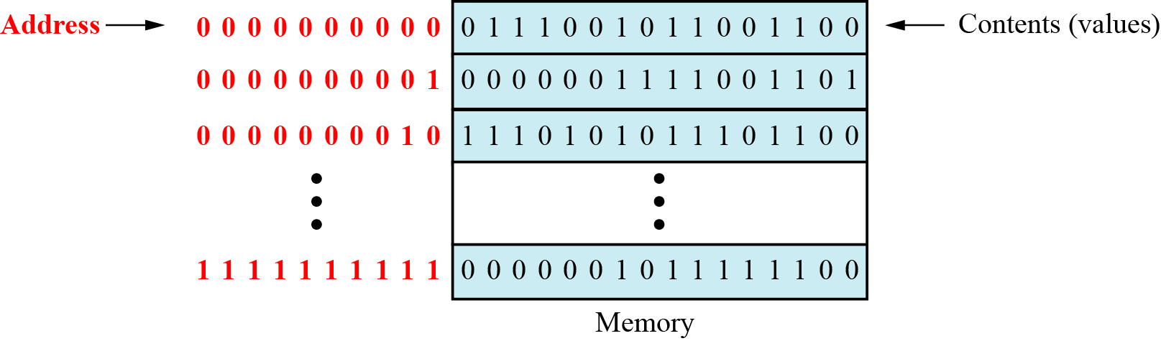
Main memory

Slide 6
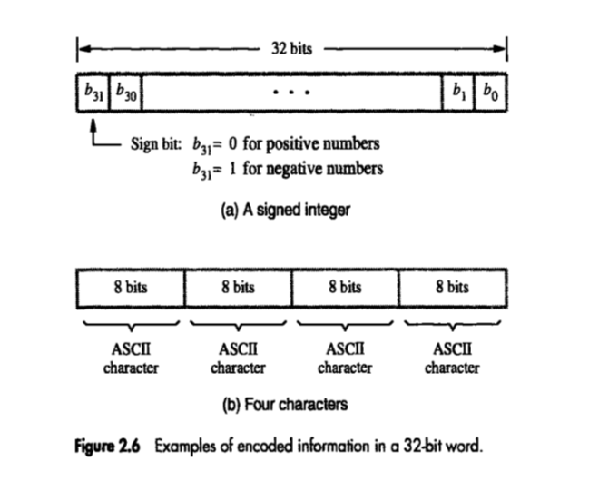

Slide 7
Address space
To access a word in memory requires an identifier. Although programmers use a name to identify a word (or a collection of words), at the hardware level each word is identified by an address.
The total number of uniquely identifiable locations in memory is called the address space.
For example, a memory with 64 kilobytes (16 address line required) and a word size of 1 byte has an address space that ranges from 0 to 65,535.

Slide 8
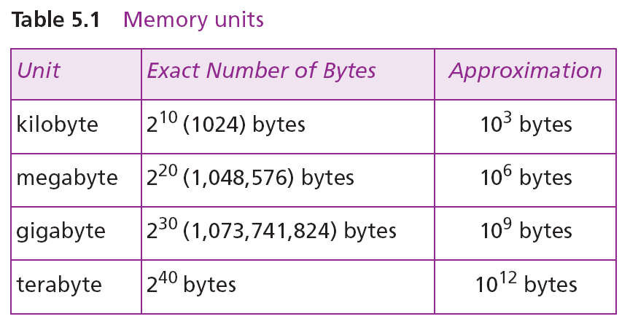
Memory addresses are defined using unsigned binary integers.

Slide 9
Example 1
A computer has 32 MB (megabytes) of memory. How many bits are needed to address any single byte in memory?
Solution
The memory address space is 32 MB, or 2⁵ (2⁵ × 2⁰). This means that we need log₂ 2²⁵, or 25 bits, to address each byte.
Example 2
A computer has 128 MB of memory. Each word in this computer is eight bytes. How many bits are needed to address any single word in memory?
Solution
The memory address space is 128 MB, which means 2⁷. However, each word is eight (2³) bytes, which means that we have 2²⁴ words. This means that we need log₂ 2²⁴, or 24 bits, to address each word.

Slide 10
MEMORY OPERATIONS
Today, general-purpose computers use a set of instructions called a program to process data.
A computer executes the program to create output data from input data
Both program instructions and data operands are stored in memory
Two basic operations requires in memory access
Load operation (Read or Fetch)-Contents of specified memory location are read by processor
Store operation (Write)- Data from the processor is stored in specified memory location

Slide 11
Assignment of Byte Address
Big-endian and little-endian are terms that describe the order in which a sequence of bytes are stored in computer memory.
Big-endian is an order in which the "bigend" (most significant value in the sequence) is stored first (at the lowest storage address).
Little-endian is an order in which the “Little end" (least significant value in the sequence) is stored first (at the lowest storage address).

Slide 12
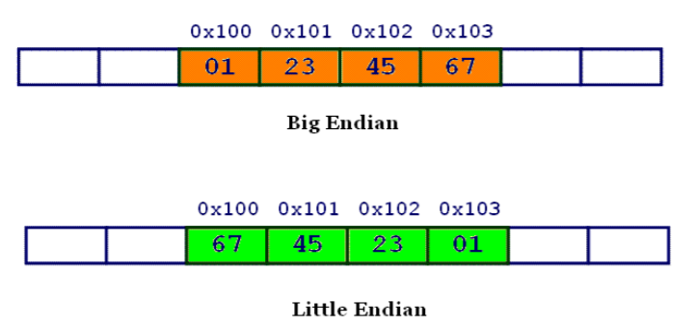

Slide 13
Assignment of byte addresses
Little Endian (e.g., in DEC, Intel)
» low order byte stored at lowest address
» byte0 byte1 byte2 byte3
Eg: 46,78,96,54 (32 bit data)
H BYTE L BYTE
8000
8001
8002
8003
8004
54
96
78
46
|

Slide 14
Big Endian
Big Endian (e.g., in IBM, Motorolla, Sun, HP)
» high order byte stored at lowest address
» byte3 byte2 byte1 byte0
Programmers/protocols should be careful when transferring binary data between Big Endian and Little Endian machines

Slide 15
Big-Endian and Little-Endian Assignments
Big-Endian: lower byte addresses are used for the most significant bytes of the word
Little-Endian: opposite ordering. lower byte addresses are used for the less significant bytes of the word
W
ord
address
Byte address
Byte address
0
0
1
2
3
0
3
2
1
0
4
4
5
6
7
4
7
6
5
4
•
•
•
•
•
•
2
k
-
4
2
k
-
4
2
k
-
3
2
k
-
2
2
k
-
1
2
k
-
4
2
k
-
1
2
k
-
2
2
k
-
3
2
k
-
4
(a) Big-endian assignment
(b) Little-endian assignment
Byte and word addressing.
Notes:
15

Slide 16
In case of 16 bit data, aligned words begin at byte addresses of 0,2,4,………………………….
In case of 32 bit data, aligned words begin at byte address of 0,4,8,………………………….
In case of 64 bit data, aligned words begin at byte addresses of 0,8,16,………………………..
In some cases words can start at an arbitrary byte address also then, we say that word locations are unaligned

